Slide 1
FGT with GWLB and TGW Security Inspection
LiuGang
2023-11-22

Slide 2












逻辑拓扑
cloudfront
Route53
IGW
App VPC-1
TGW attachment
Security VPC
TGW attachment
AZ1
Endpoints
NAT gateway
FortiGate
TGW
ALB
GWLB
Endpoints
App VPC-2
NAT gateway
AZ2
TGW attachment
TGW attachment
FGT integrate with TGW and GWLB 南北和东西向流量上云安全检查

Slide 3
NS Traffic Inspect
cloudfront
Route53
IGW
App VPC-1
TGW attachment
Security VPC
TGW attachment
AZ1
NS-in
Endpoints
EW
Endpoints
NS-out Endpoints
NAT gateway
FortiGate
TGW
ALB
GWLB
NS-in
Endpoints
NAT gateway
App VPC-2
EW
Endpoints
AZ2
TGW attachment
NS-out Endpoints
TGW attachment
FGT integrate with TGW and GWLB 南北向流量上云安全检查

Slide 4
EW Traffic Inspect
cloudfront
Route53
IGW
App VPC-1
TGW attachment
Security VPC
TGW attachment
AZ1
NS-in
Endpoints
EW
Endpoints
NS-out Endpoints
NAT gateway
FortiGate
TGW
ALB
GWLB
NS-in
Endpoints
NAT gateway
App VPC-2
EW
Endpoints
AZ2
TGW attachment
NS-out Endpoints
TGW attachment
FGT integrate with TGW and GWLB 东西向流量上云安全检查

Slide 5
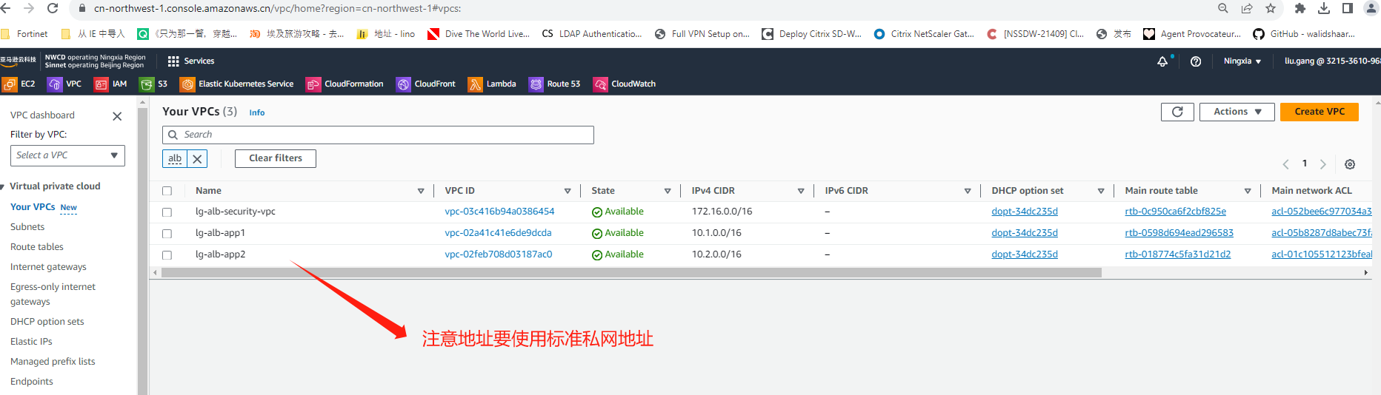
VPC规划

Slide 6
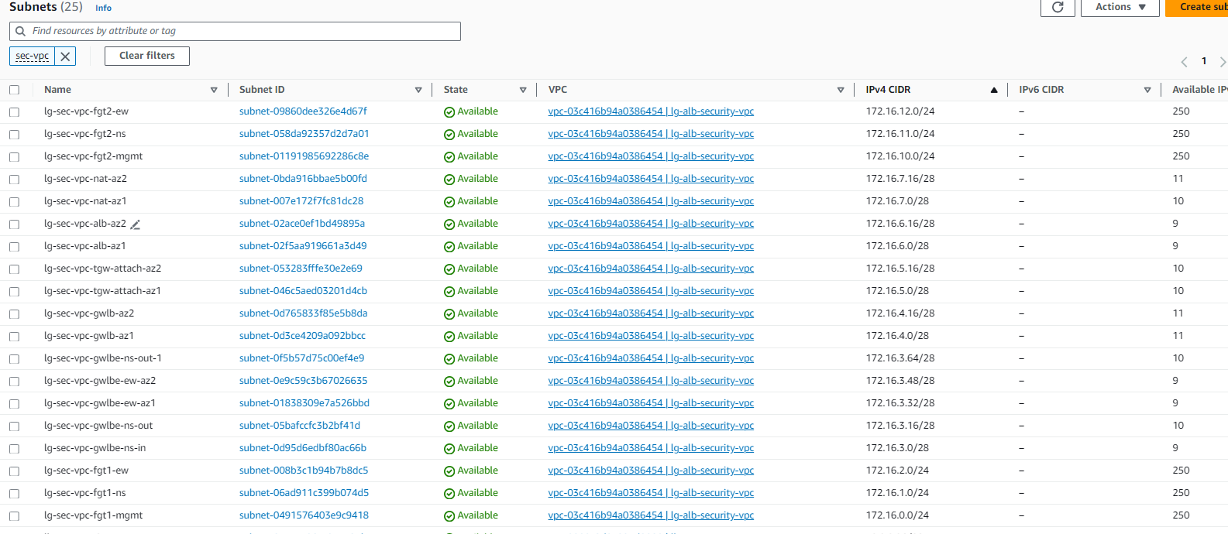
Security VPC Subnet规划
防火墙每台设备3块网卡，分别用于管理口、南北流量控制业务接口、东西向业务控制接口;
NAT/ALB/GWLB/GWLBE(NS[in/out]/EW)/tgw attachment建议基于Server部署AZ来规划，通常建议双AZ部署提升冗余性；
Notes:
目前推荐c6g.large实例使用基于graviton arm镜像FGT

Slide 7
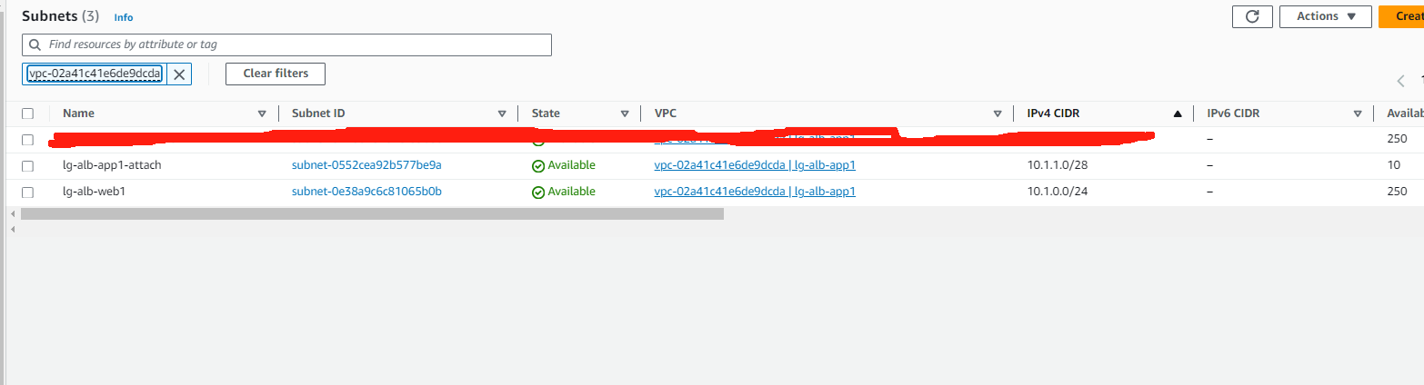
App VPC-1规划
Server/TGW Attachment建议基于Server部署AZ来规划，通常建议双AZ部署提升冗余性；

Slide 8
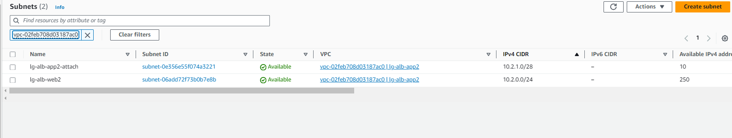
App VPC-2规划
Server/TGW Attachment建议基于Server部署AZ来规划，通常建议双AZ部署提升冗余性；

Slide 9
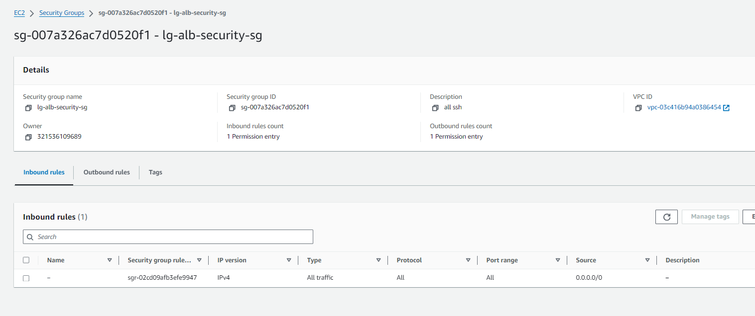
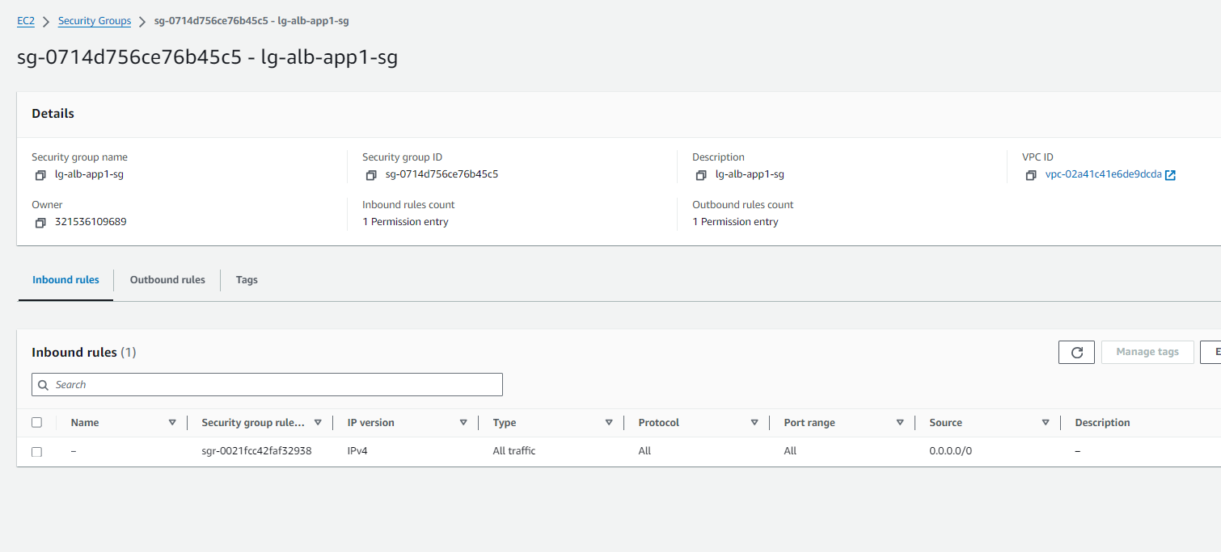
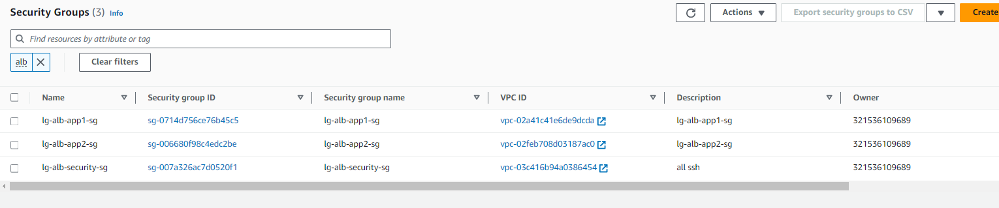
安全组
安全组防火墙管理口建议开通443 22
业务几口流量可以全开或者仅开通UDP 6081（Geneve隧道） TCP 8008（probe-http健康检查） 以及业务需要开通的端口 例如443 80等

Slide 10
防火墙配置(vdom global and root)
config system vdom-property
edit "root"
set description "property limits for vdom root"
set snmp-index 1
next
edit "EW-Traffic"
set description "property limits for vdom EW-Traffic"
set snmp-index 3
next
edit "NS-Traffic"
set description "property limits for vdom NS-Traffic"
set snmp-index 2
next
End
config system probe-response
set mode http-probe
End
config router static
edit 1
set gateway x.x.x.1(AWS subnet 网关地址)
set device "port1"
next
end
config system interface
edit "port1"
set vdom "root"
set ip x.x.x.x
set allowaccess ping https ssh
set type physical
set snmp-index 1
set mtu-override enable
set mtu 9001
next
edit "port2"
set vdom "NS-Traffic"
set ip x.x.x.x
set allowaccess ping probe-response
set type physical
set snmp-index 6
set defaultgw disable
set mtu-override enable
set mtu 9001
next
edit "port3"
set vdom "EW-Traffic"
set ip x.x.x.x
set allowaccess ping probe-response
set type physical
set snmp-index 7
set defaultgw disable
set mtu-override enable
set mtu 9001
next
手工设置管理路由防止地址丢失导致无法管理
port1划入root vdom ， port2划入 NS vdom ，port3划入EW vdom
开启probe-response探测功能

Slide 11
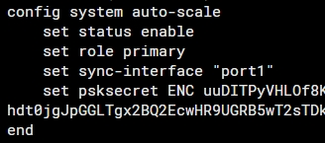
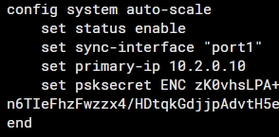
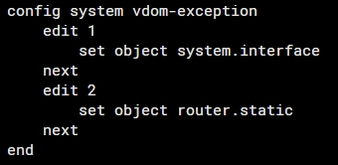
FGT配置auto-scale
通过配置auto-scale实现配置自动同步，FQDN解析记录也会同步

Slide 12
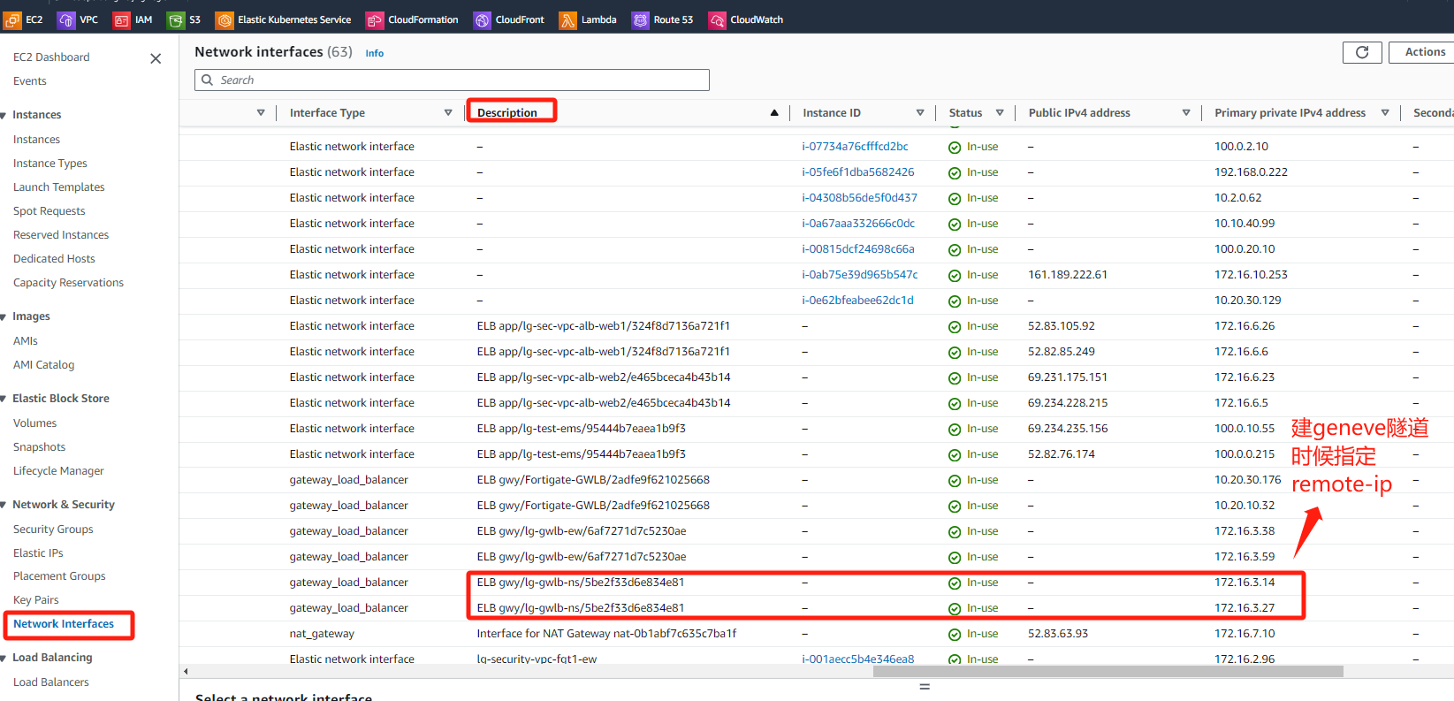
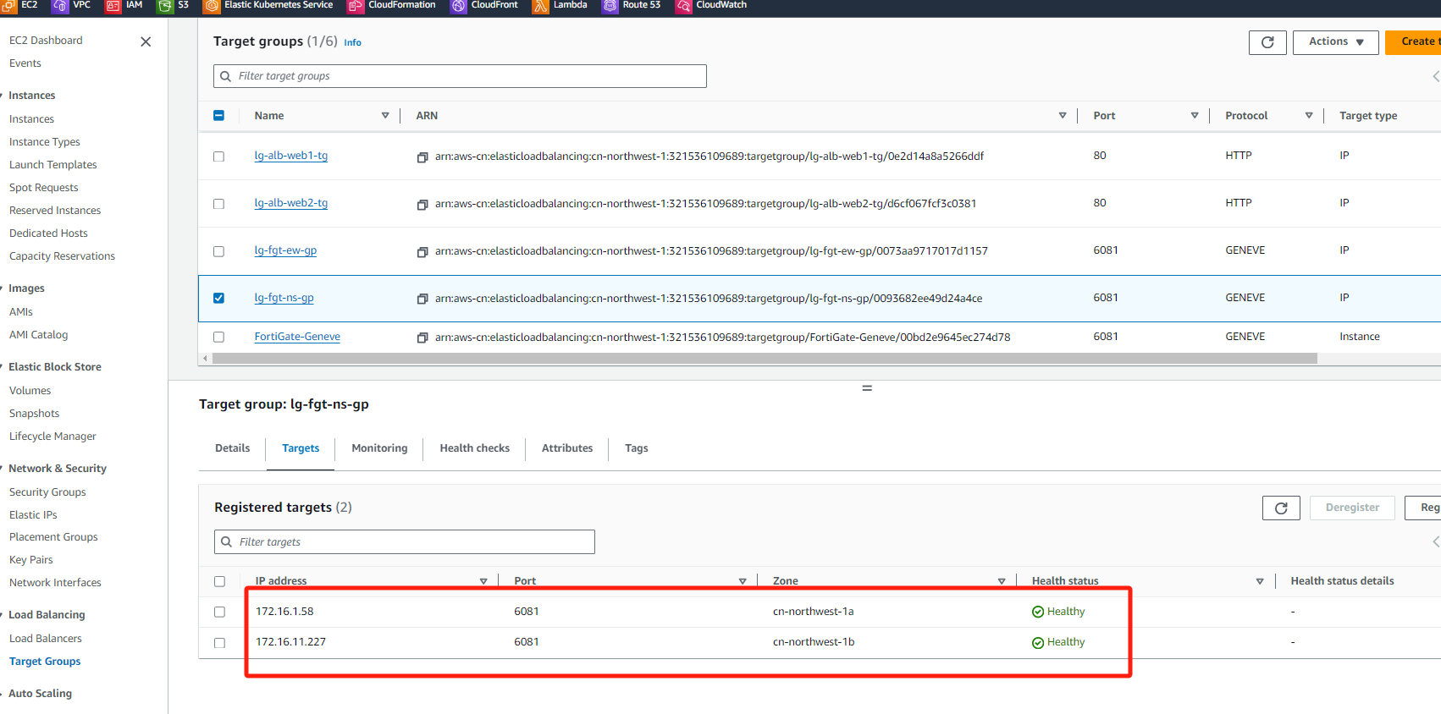
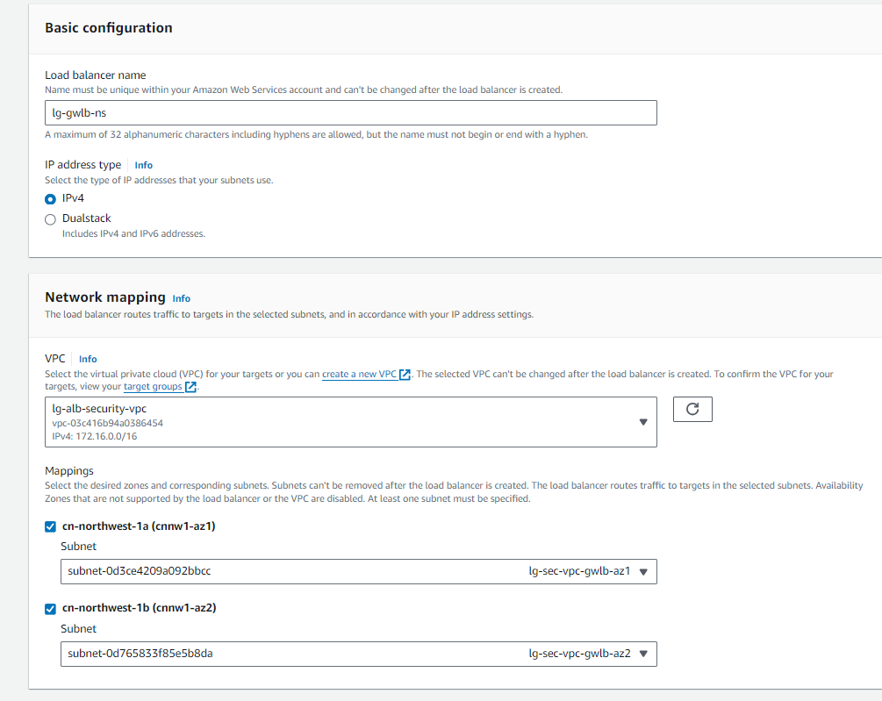
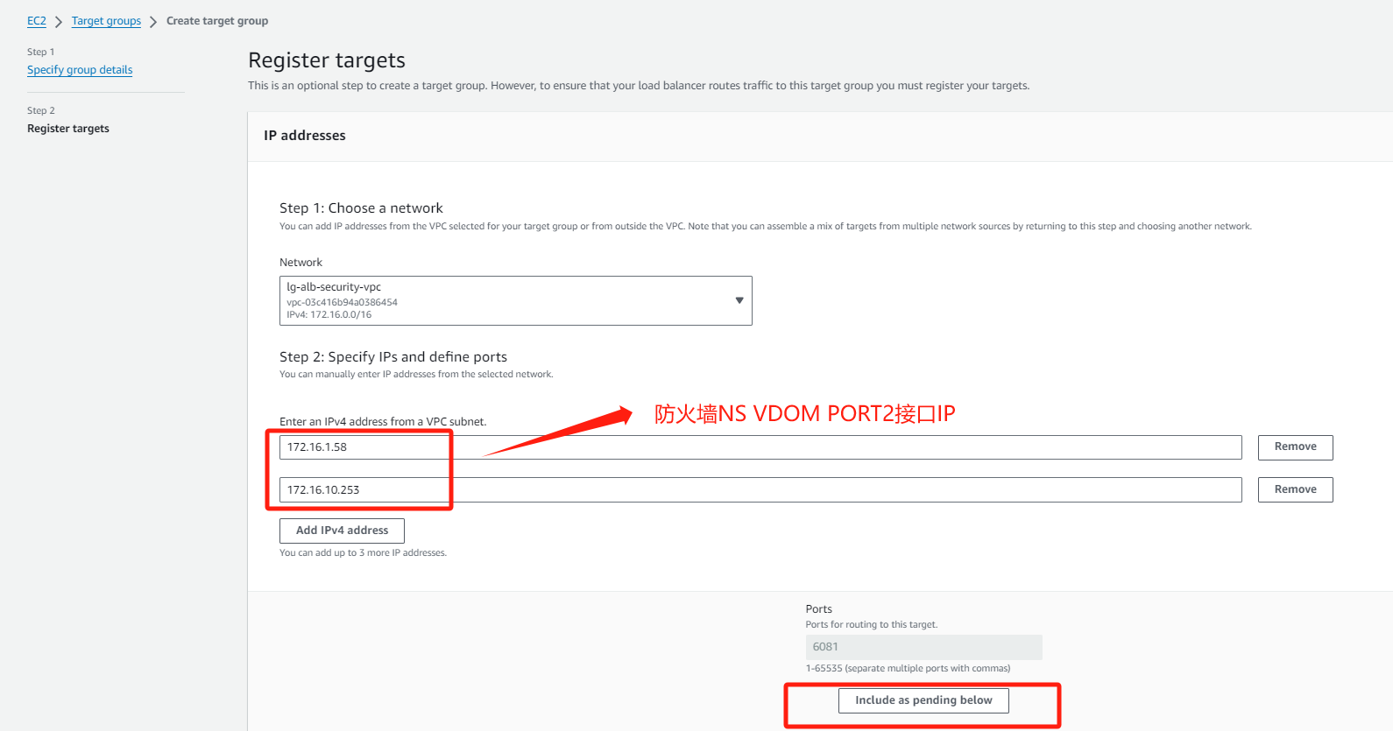
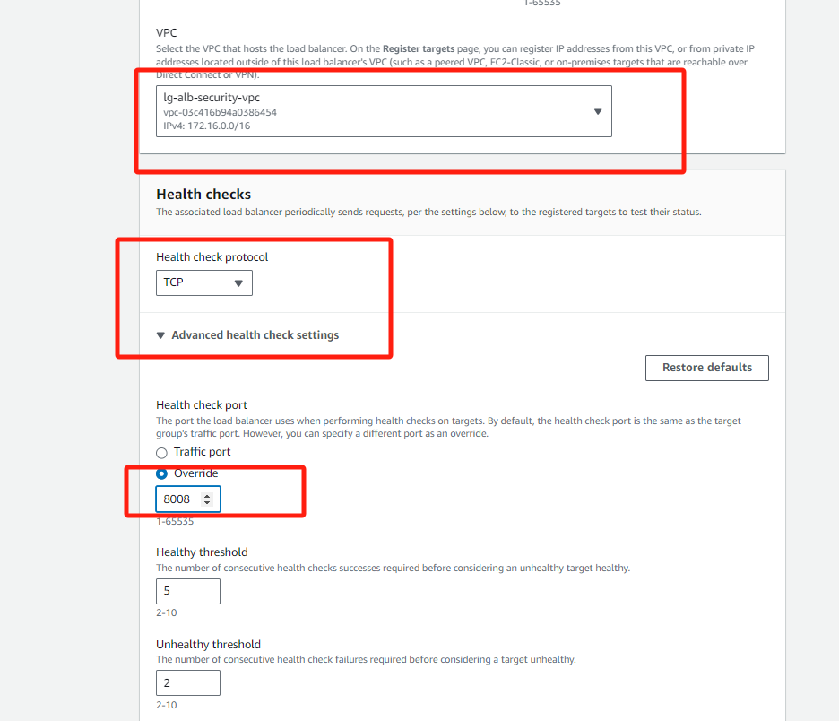
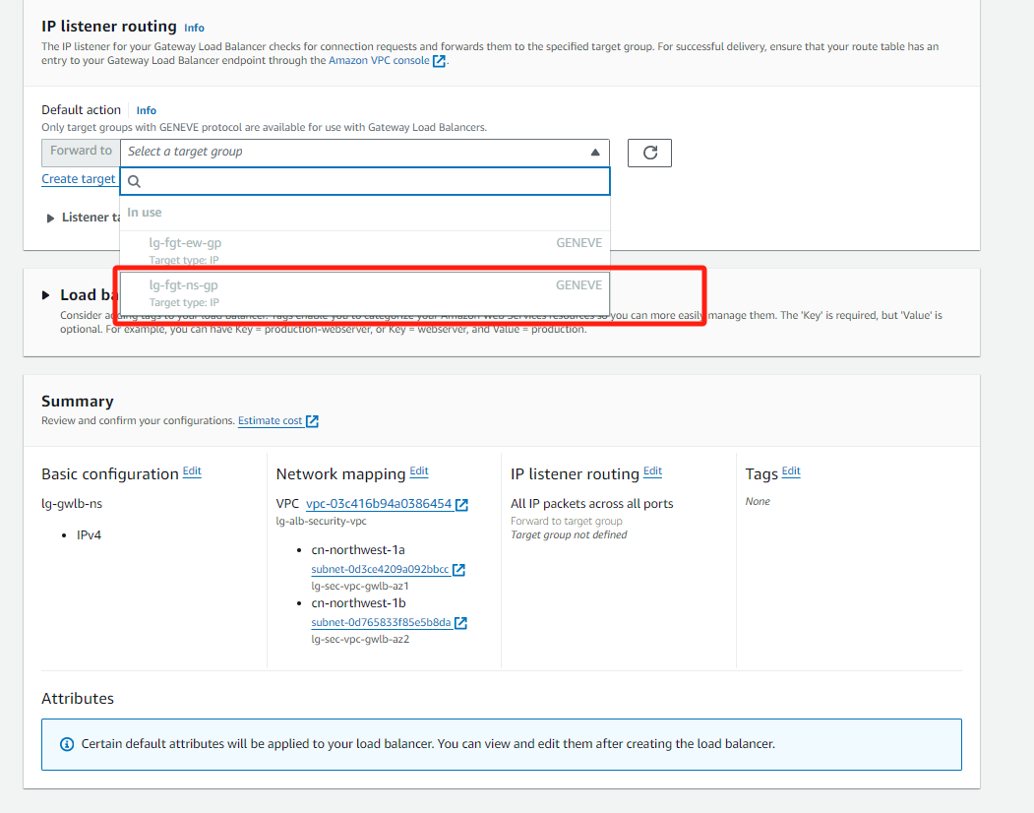
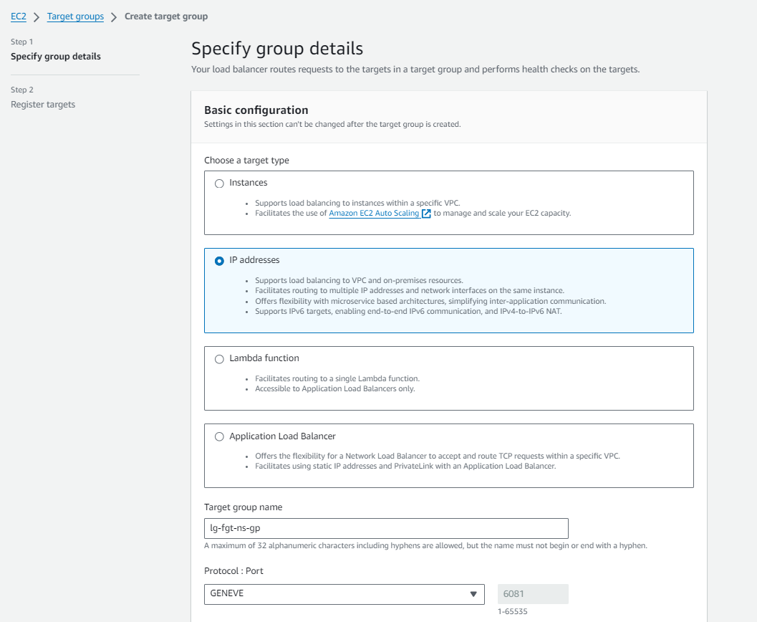
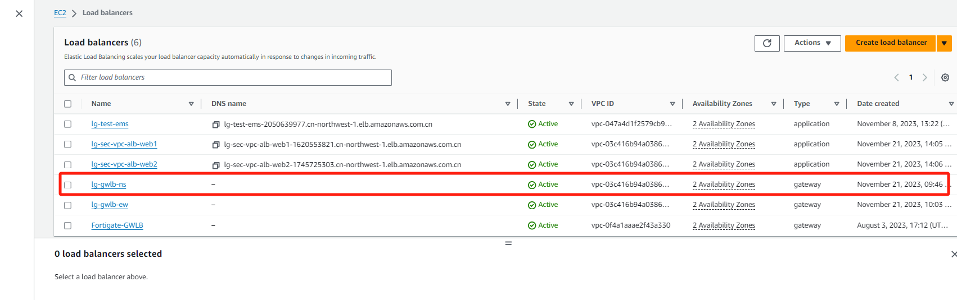
GWLB-NS

Slide 13
防火墙配置(vdom NS)
config system geneve
edit "geneve-ns-1"
set interface "port2"
set type ppp
set remote-ip x.x.x.x (gwlb配置后查看gwlb eni获取网卡地址)
next
edit "geneve-ns-2"
set interface "port2"
set type ppp
set remote-ip x.x.x.x
next
End
config router static
edit 1
set dst x.x.x.x x.x.x.x (回指GWLB ENI网段的路由)
set gateway x.x.x.x
set device "port2"
next
edit 2
set device "geneve-ns-1"
next
edit 3
set device "geneve-ns-2"
next
end
config firewall policy
edit 1
set name "NS-Traffic-Policy"
set srcintf "NS-Traffic-Zone"
set dstintf "NS-Traffic-Zone"
set action accept
set srcaddr "all"
set dstaddr "all"
set schedule "always"
set service "ALL"
set utm-status enable
set ssl-ssh-profile "deep-inspection"
set av-profile "g-default"
set ips-sensor "g-default"
set logtraffic all
set tcp-mss-sender 1000 (用于处理ALB过来的流量)
set tcp-mss-receiver 1000
next
end
config router policy
edit 1
set input-device "geneve-ns-1"
set output-device "geneve-ns-1"
next
edit 2
set input-device "geneve-ns-2"
set output-device "geneve-ns-2"
next
End
config system zone
edit "NS-Traffic-Zone"
set interface "geneve-ns-1" "geneve-ns-2"
next
End

Slide 14
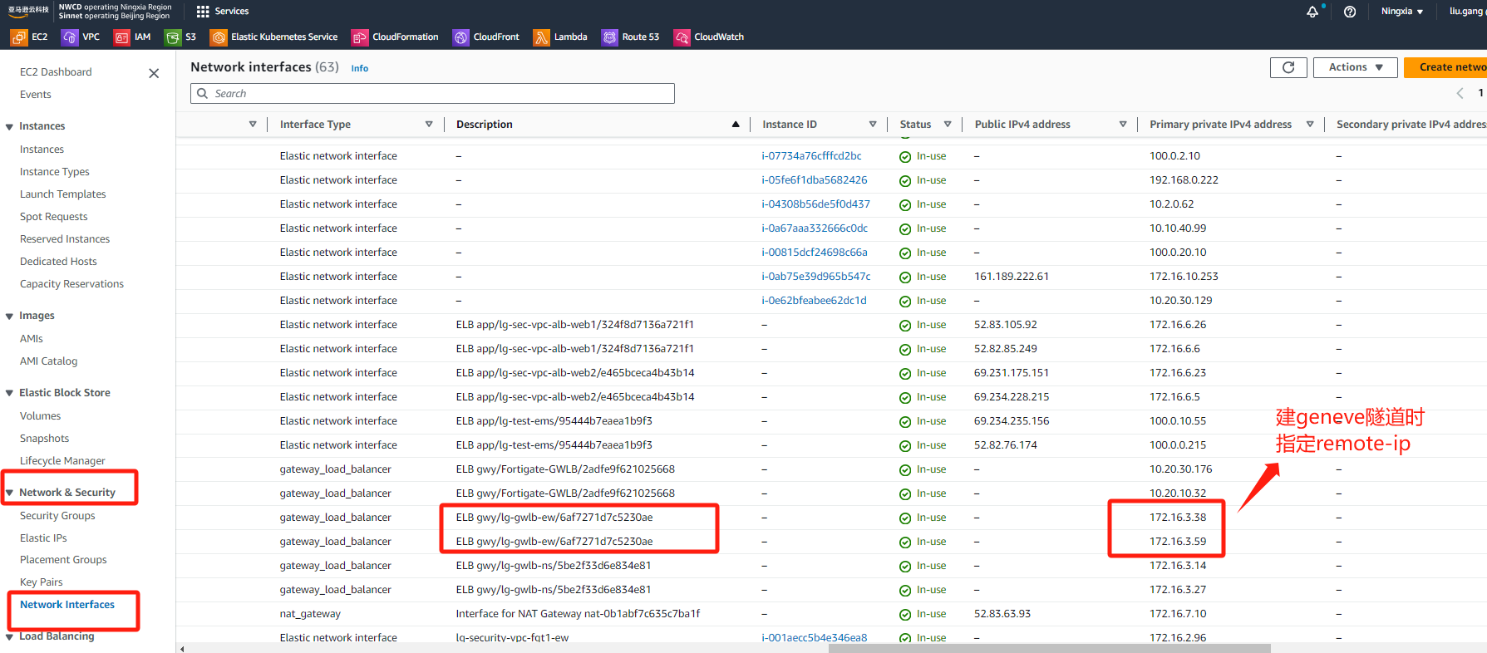
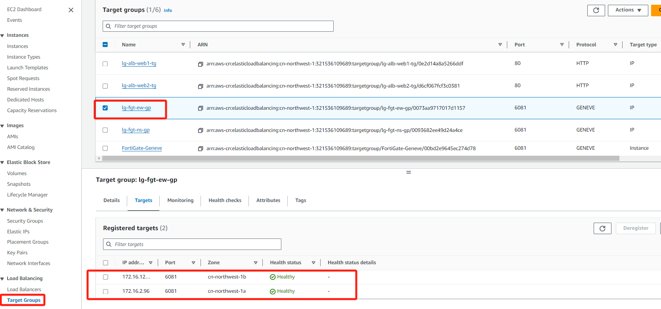
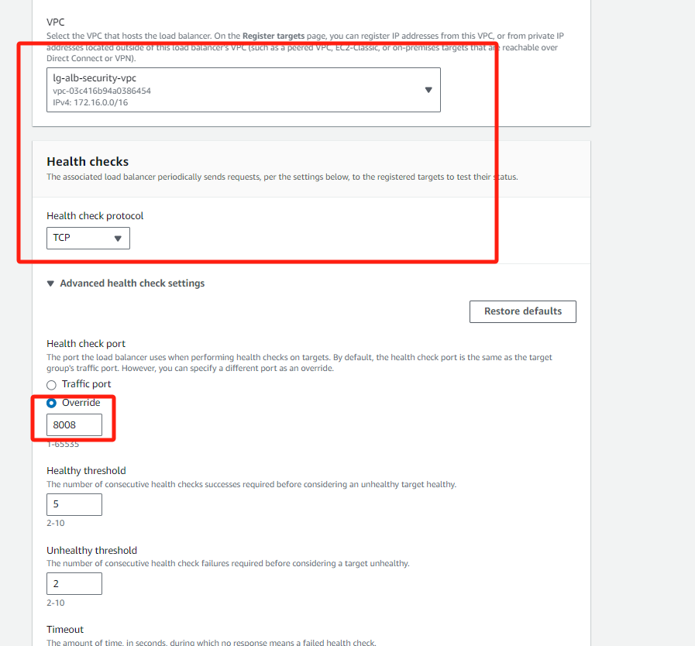
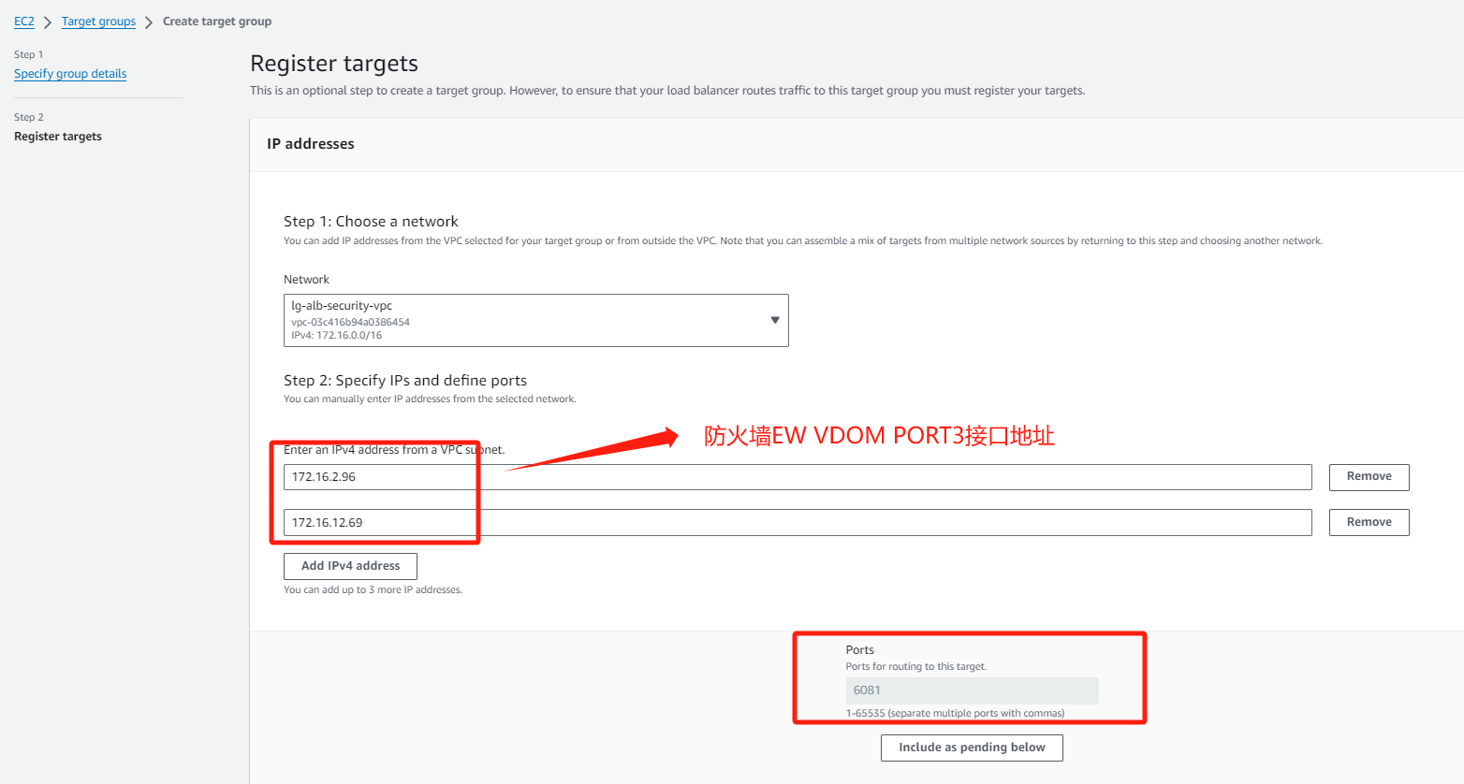
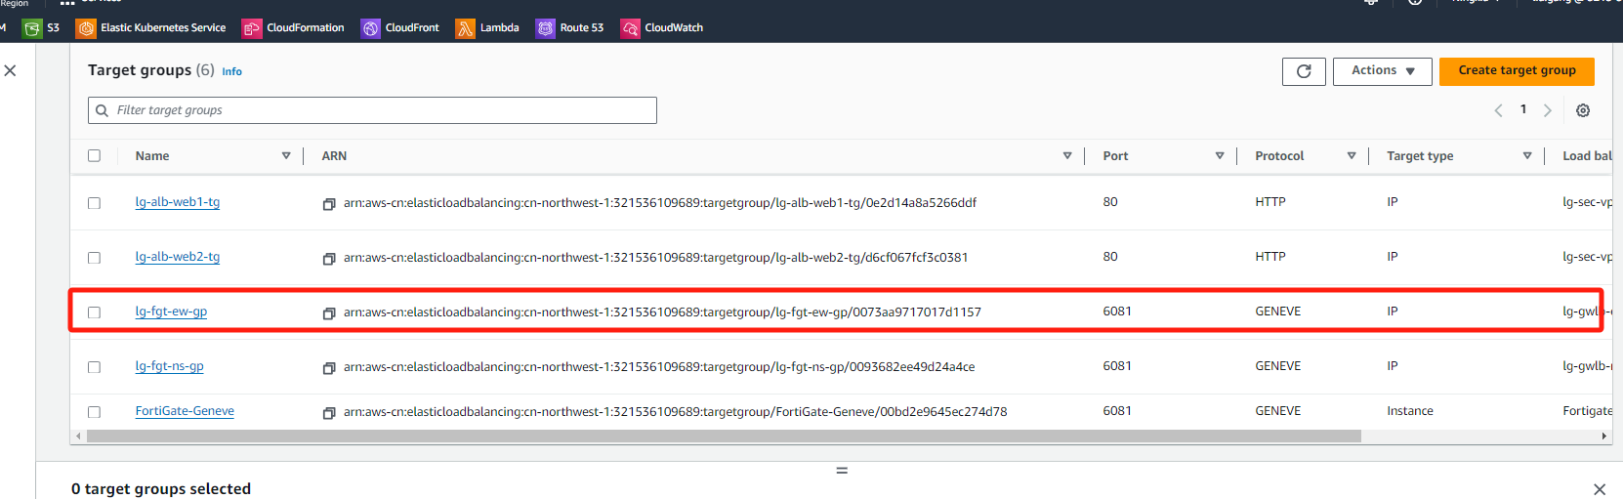
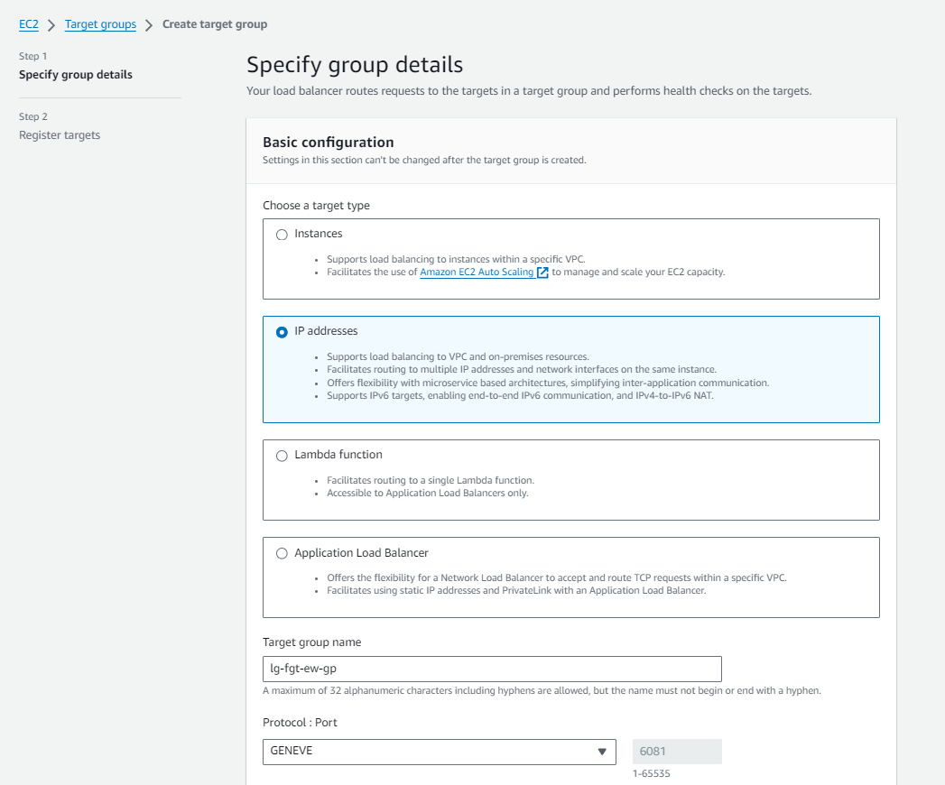
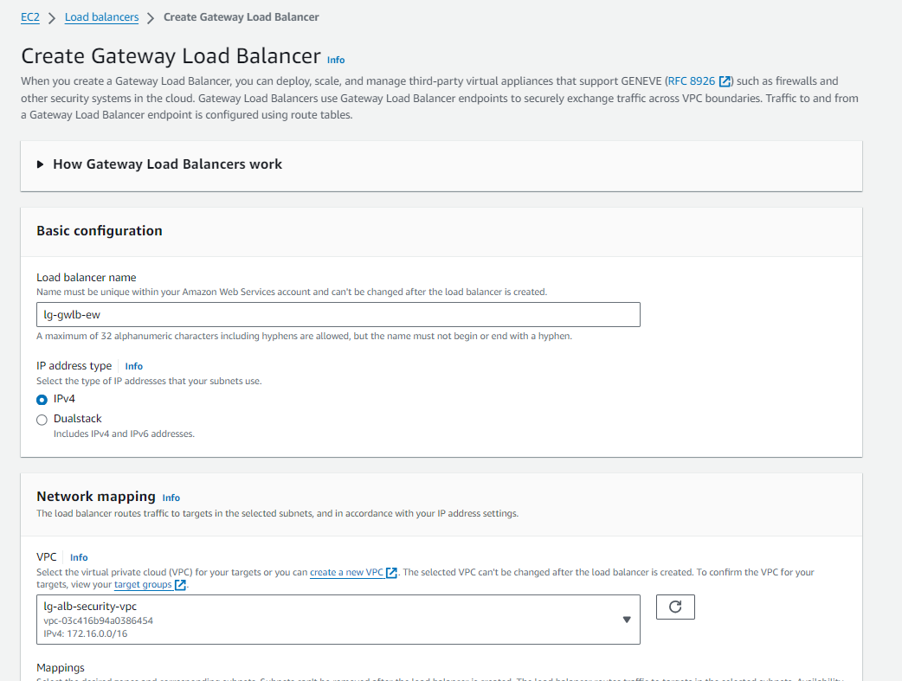
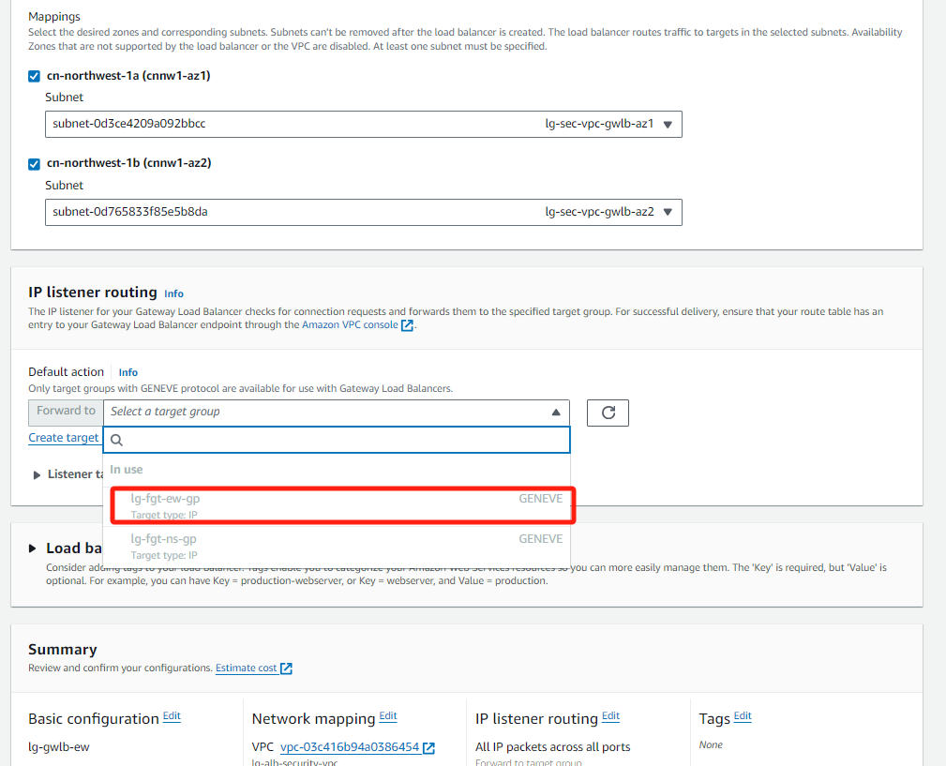
GWLB-EW

Slide 15
防火墙配置(vdom EW)
config system geneve
edit "geneve-ns-1"
set interface "port3"
set type ppp
set remote-ip x.x.x.x (gwlb配置后查看gwlb eni获取网卡地址)
next
edit "geneve-ns-2"
set interface "port3"
set type ppp
set remote-ip x.x.x.x
next
End
config router static
edit 1
set dst x.x.x.x x.x.x.x (回指GWLB ENI网段的路由)
set gateway x.x.x.x
set device "port3"
next
edit 2
set device "geneve-ew-1"
next
edit 3
set device "geneve-ew-2"
next
end
config router policy
edit 1
set input-device "geneve-ew-1"
set output-device "geneve-ew-1"
next
edit 2
set input-device "geneve-ew-2"
set output-device "geneve-ew-2"
next
End
config system zone
edit "NS-Traffic-Zone"
set interface "geneve-ew-1" "geneve-ew-2"
next
End
config firewall policy
edit 1
set name "EW-Traffic-Policy"
set srcintf "EW-Traffic-Zone"
set dstintf "EW-Traffic-Zone"
set action accept
set srcaddr "all"
set dstaddr "all"
set schedule "always"
set service "ALL"
set utm-status enable
set ssl-ssh-profile "certificate-inspection"
set av-profile "g-default"
set ips-sensor "g-default"
set logtraffic all
next
end

Slide 16
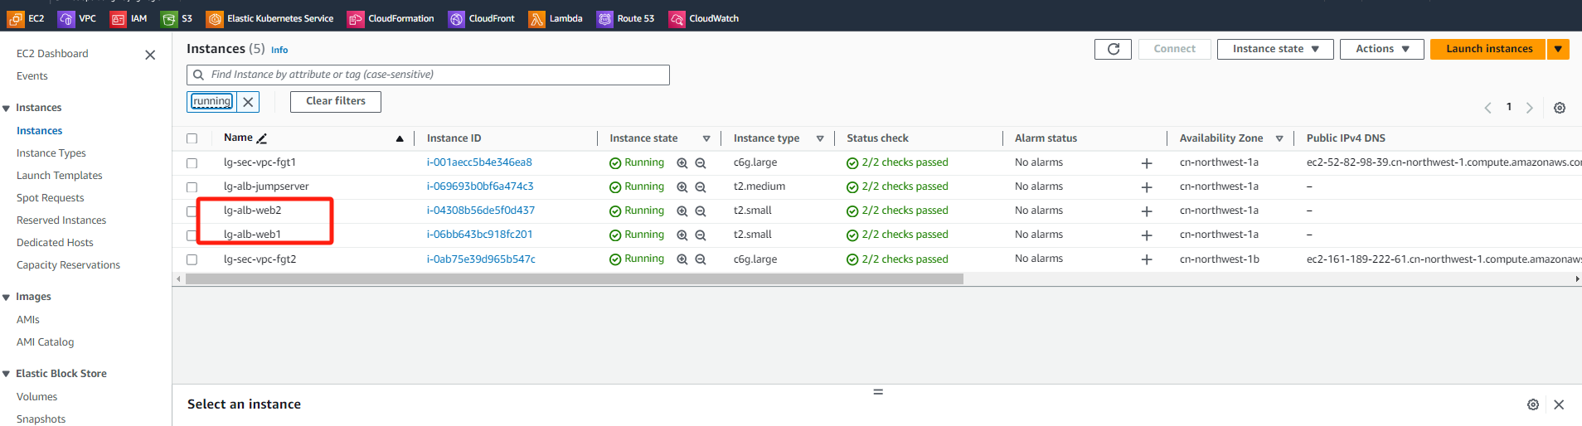
业务ECS实例创建
验证环境总共2台ECS WEB服务器分别位于不同VPC，一台跳板机用于测试东西流量访问，2台防火墙FGT部署在security VPC

Slide 17
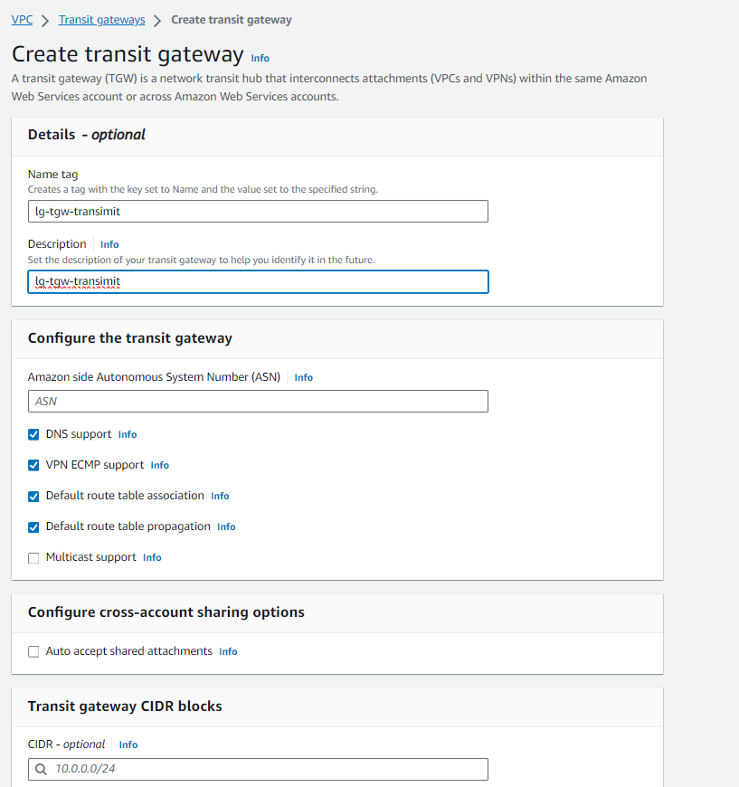
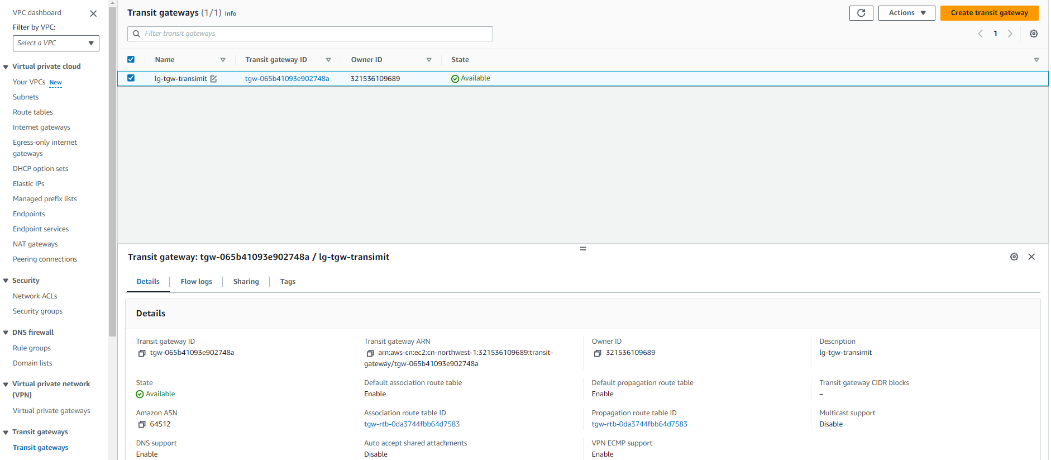
TGW规划

Slide 18
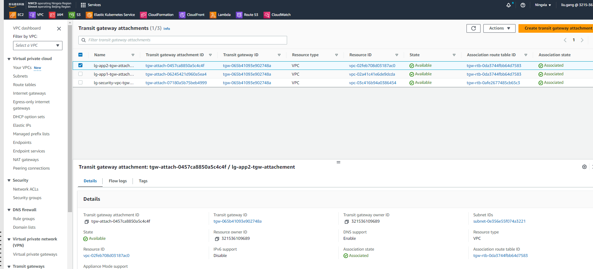
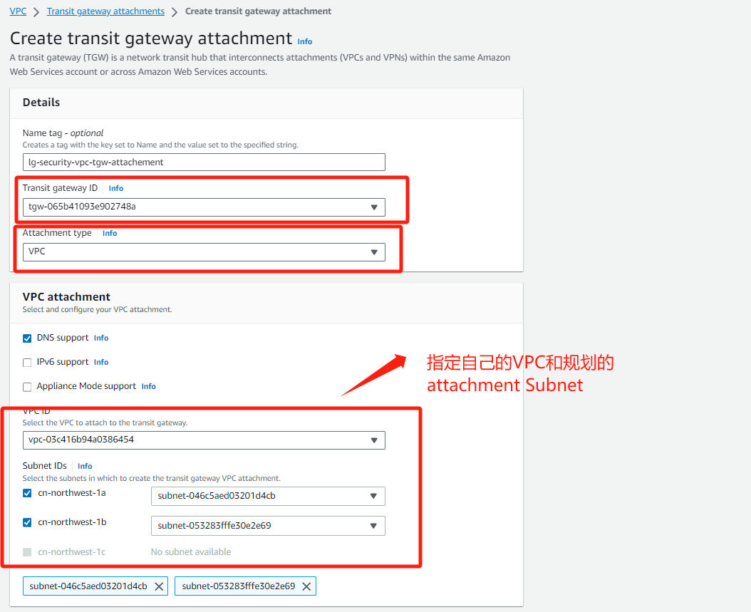
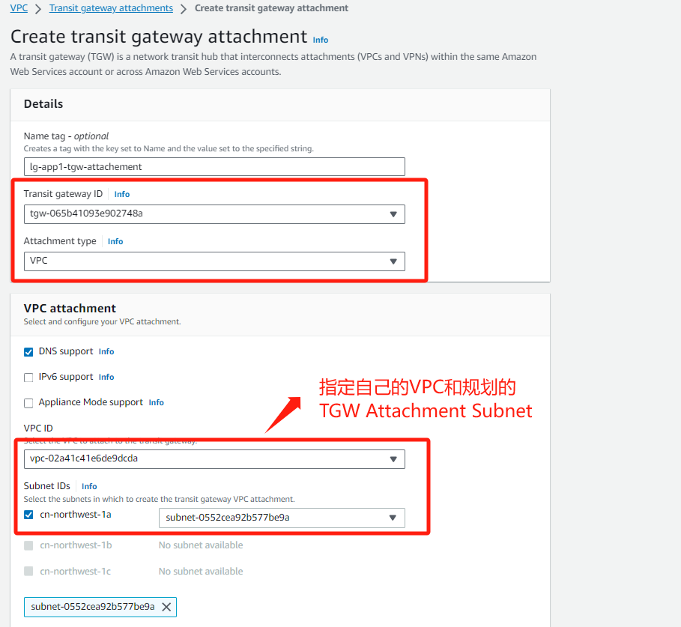
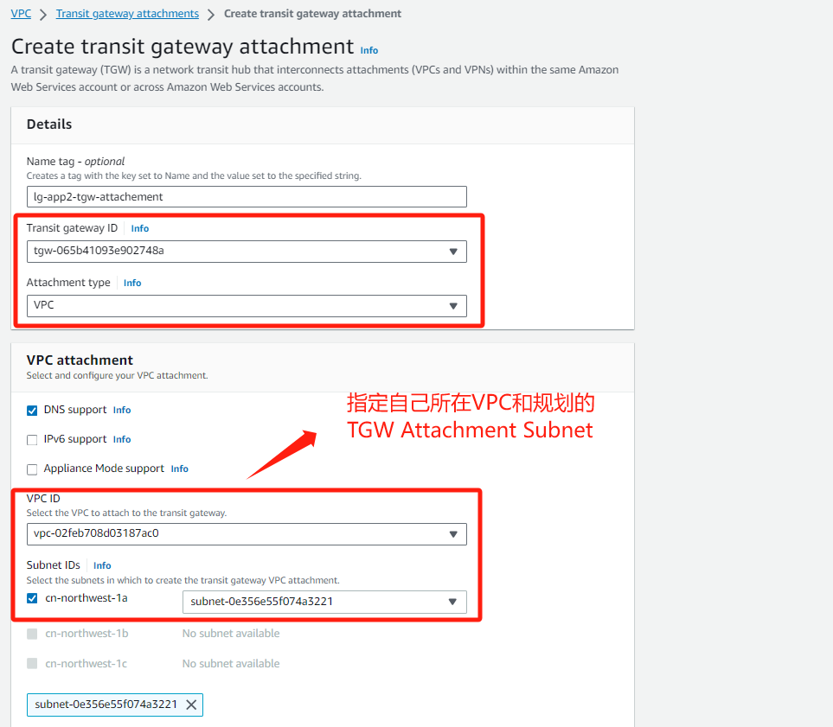
TGW Attachment规划

Slide 19
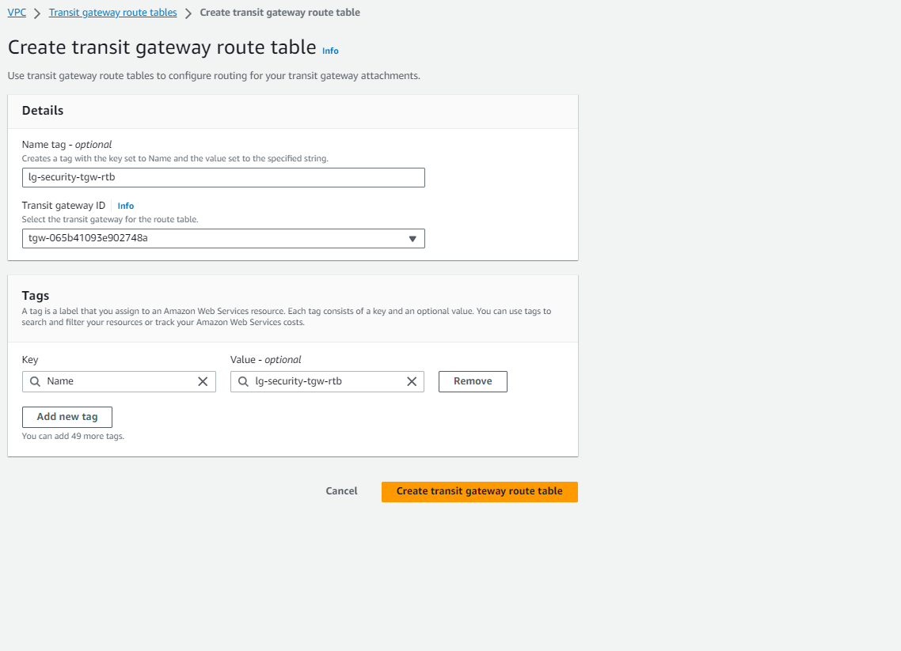
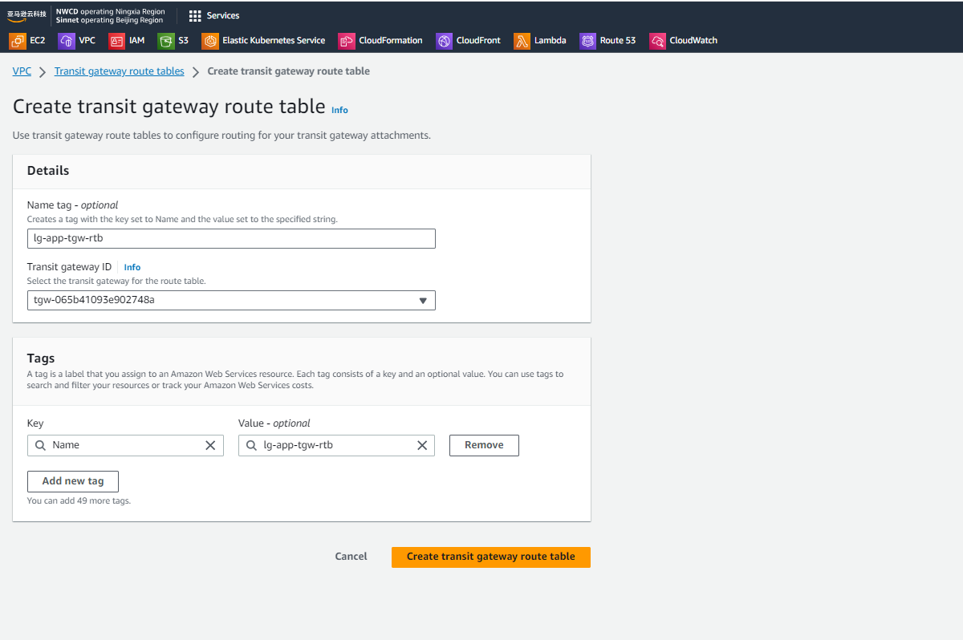
TGW 路由规划-1

Slide 20
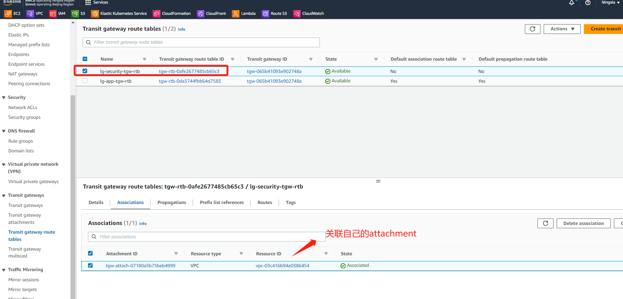
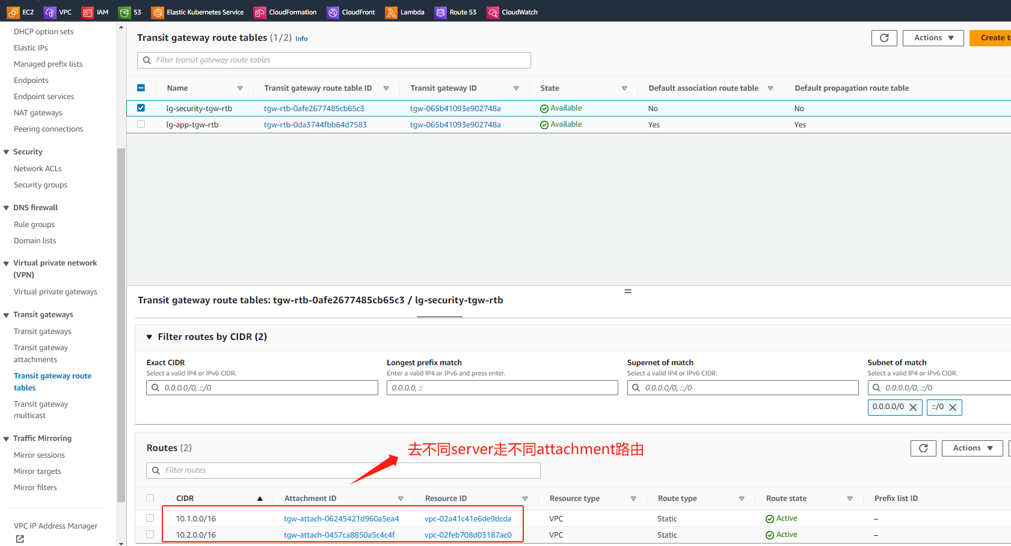
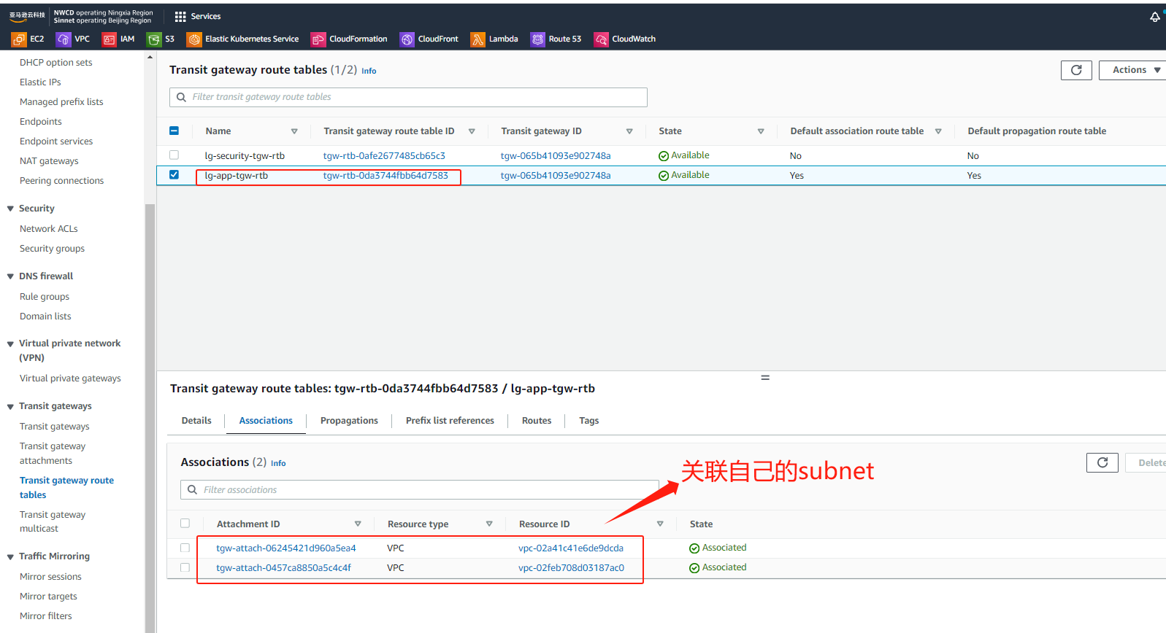
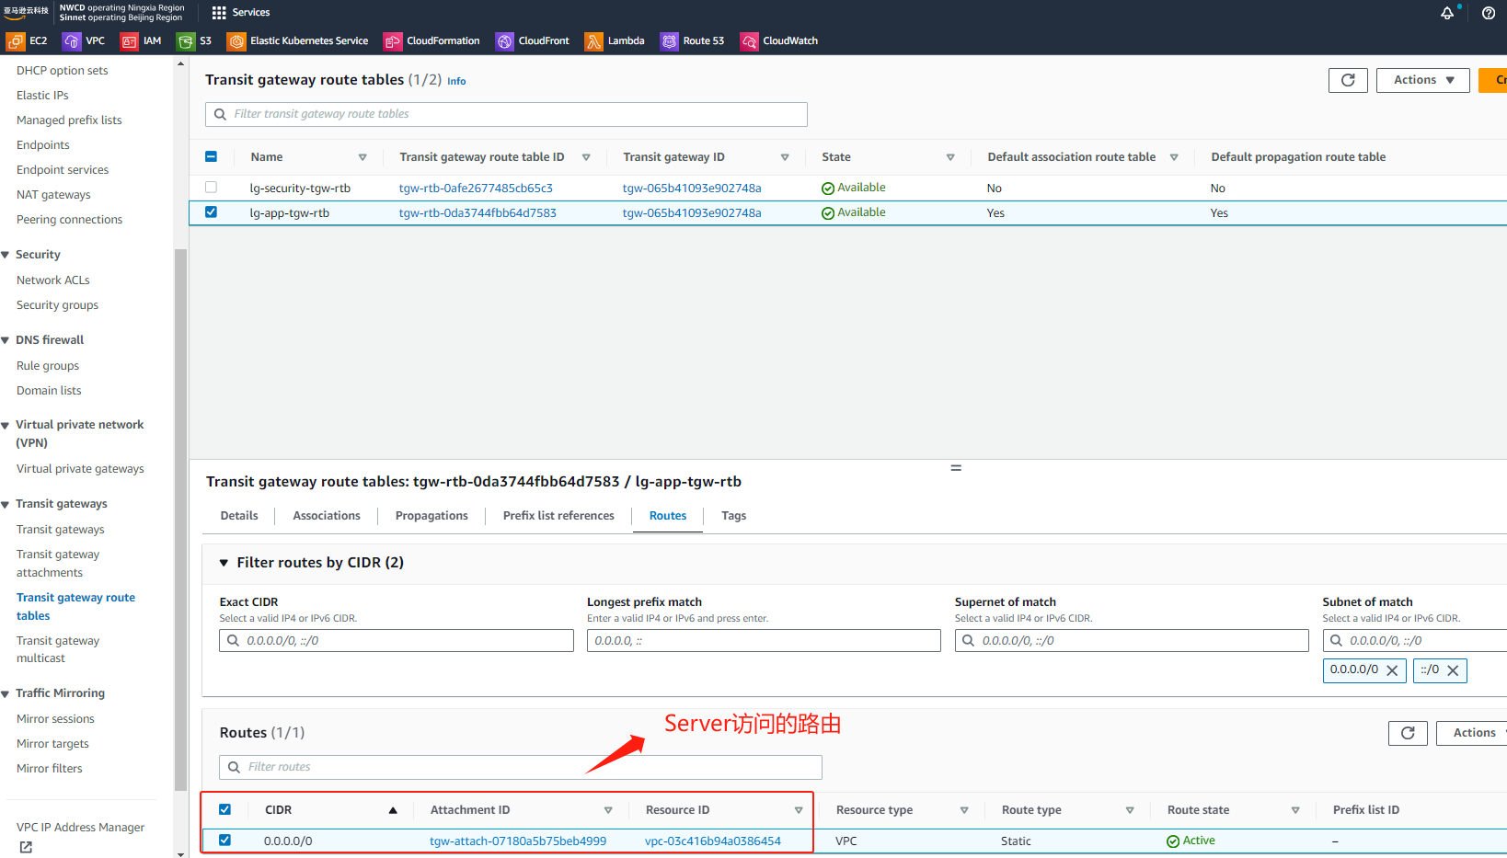
TGW 路由规划-2

Slide 21
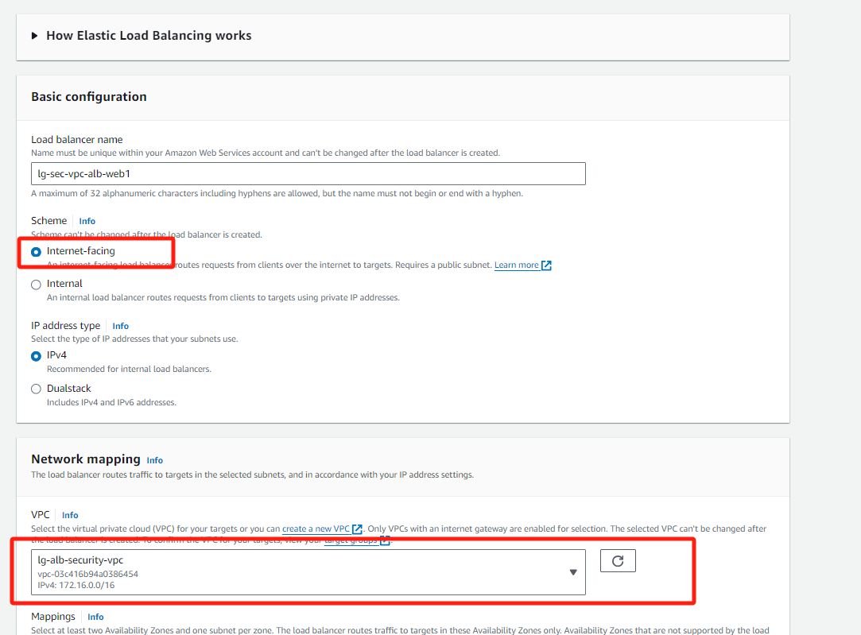
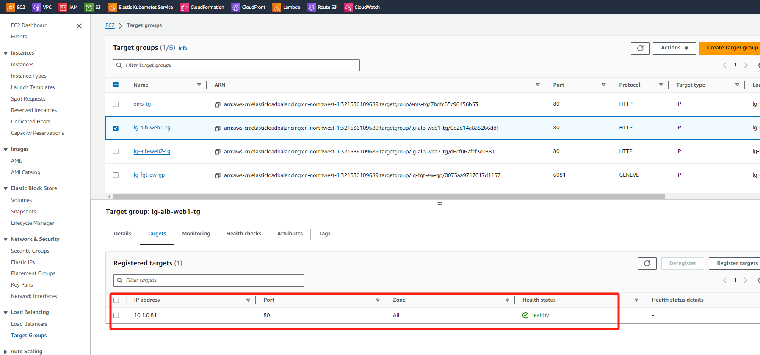
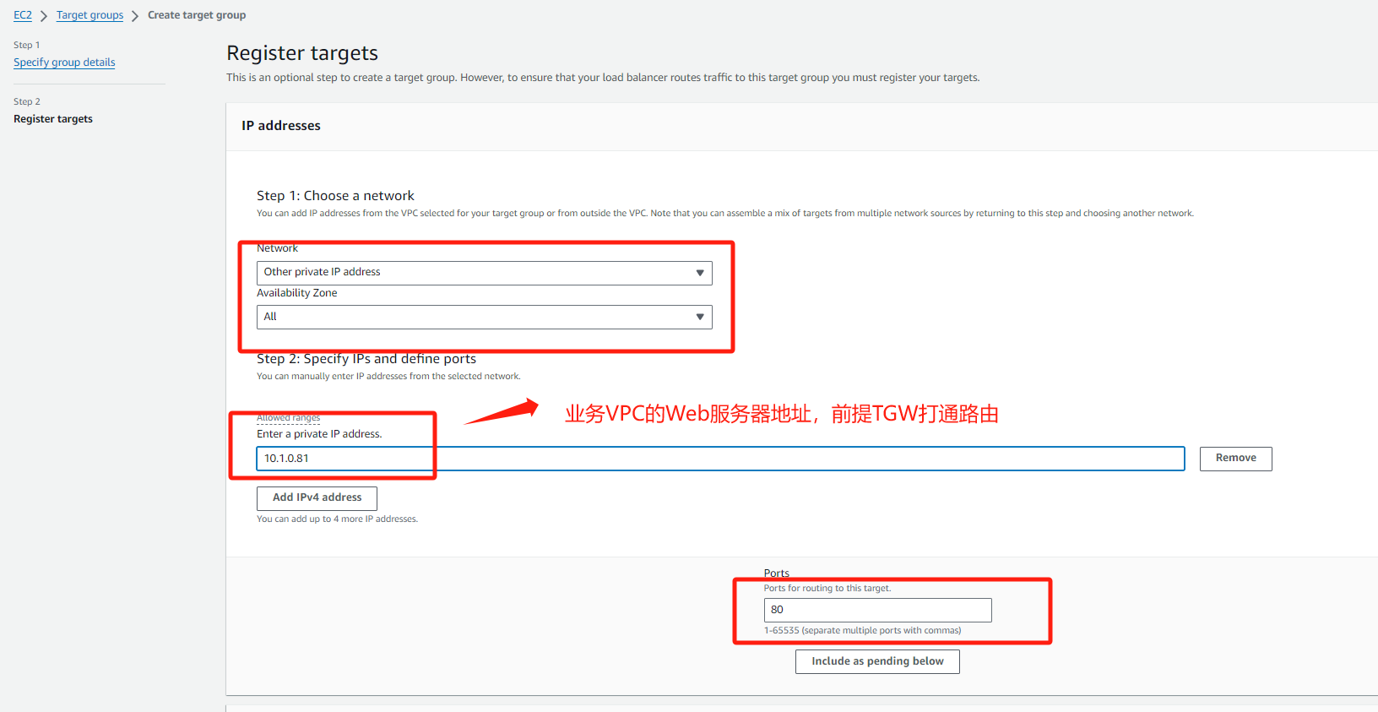
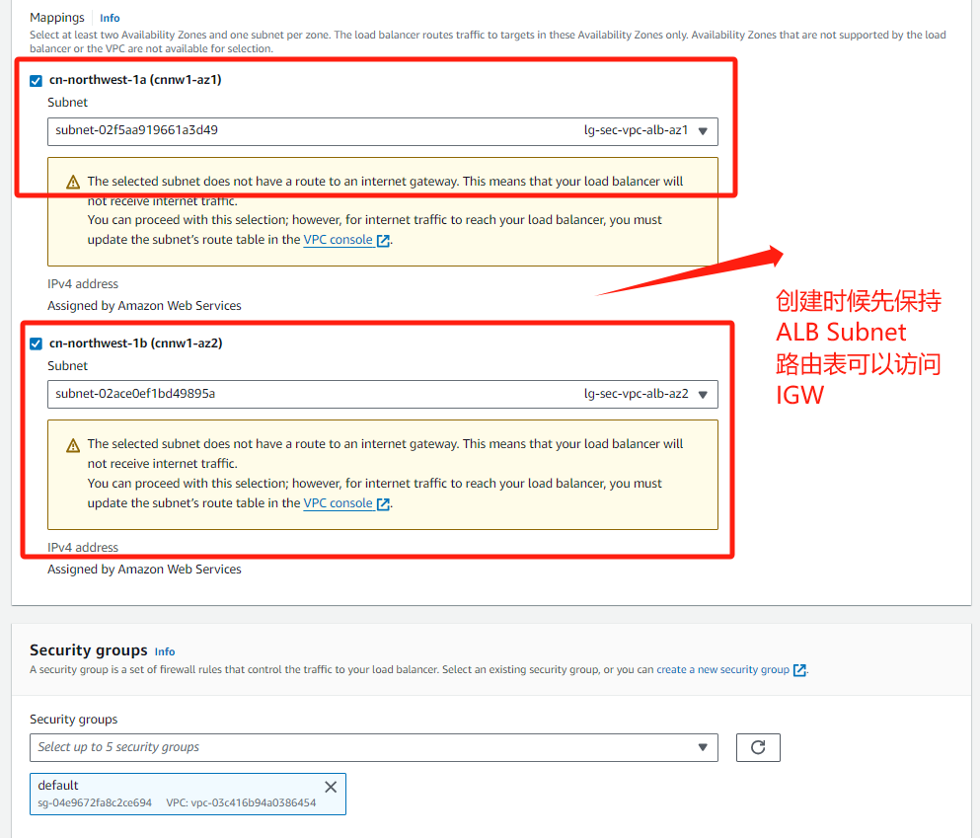
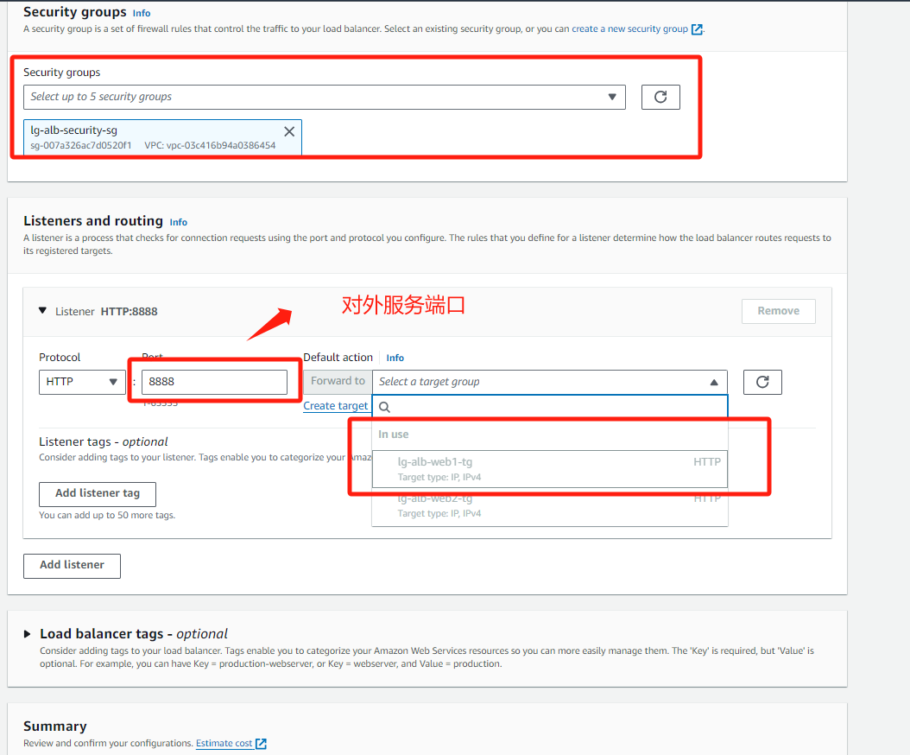
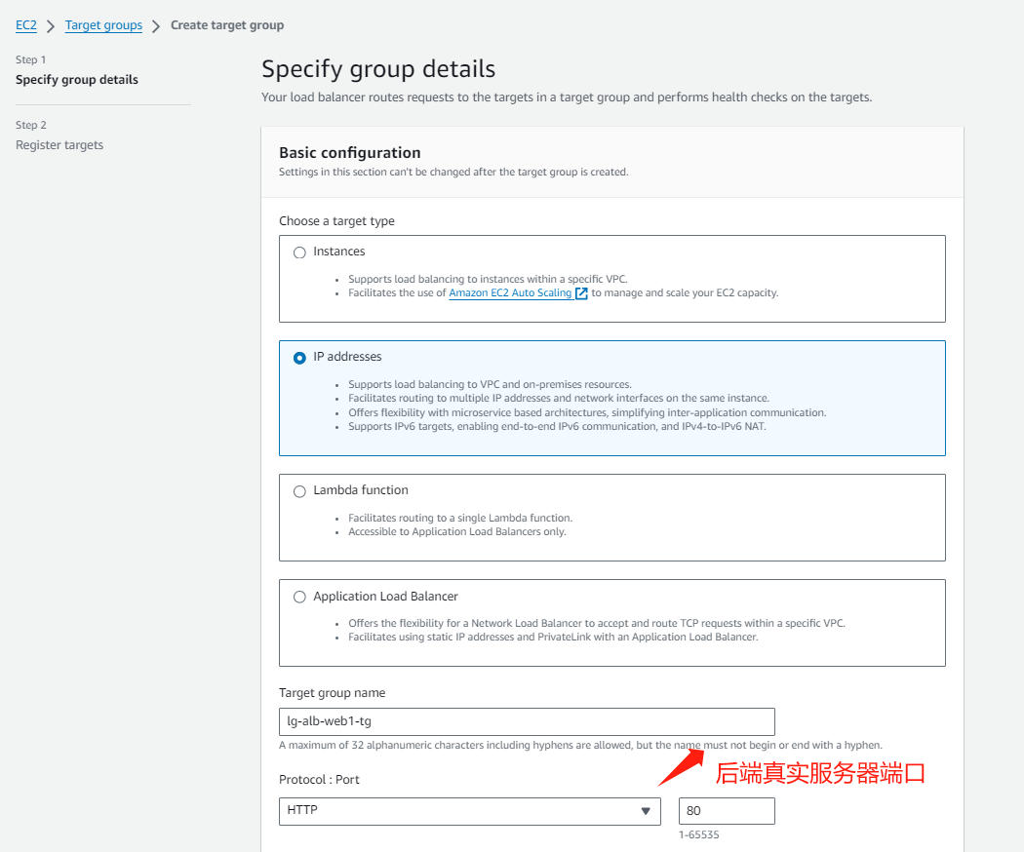
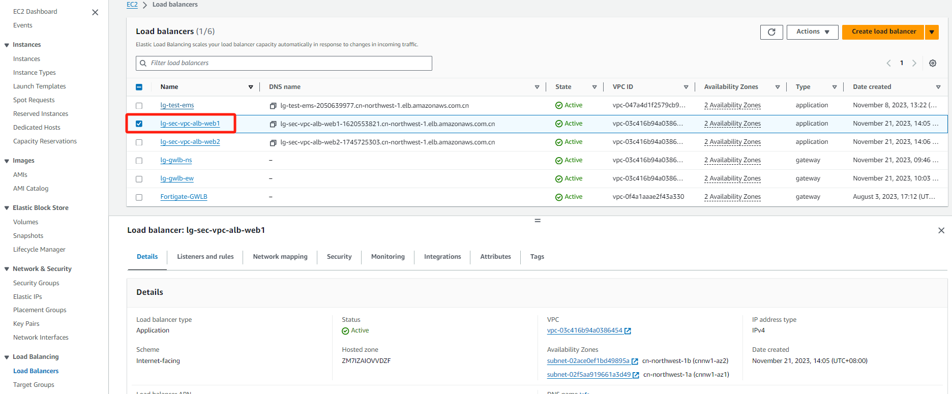
业务ALB-1

Slide 22
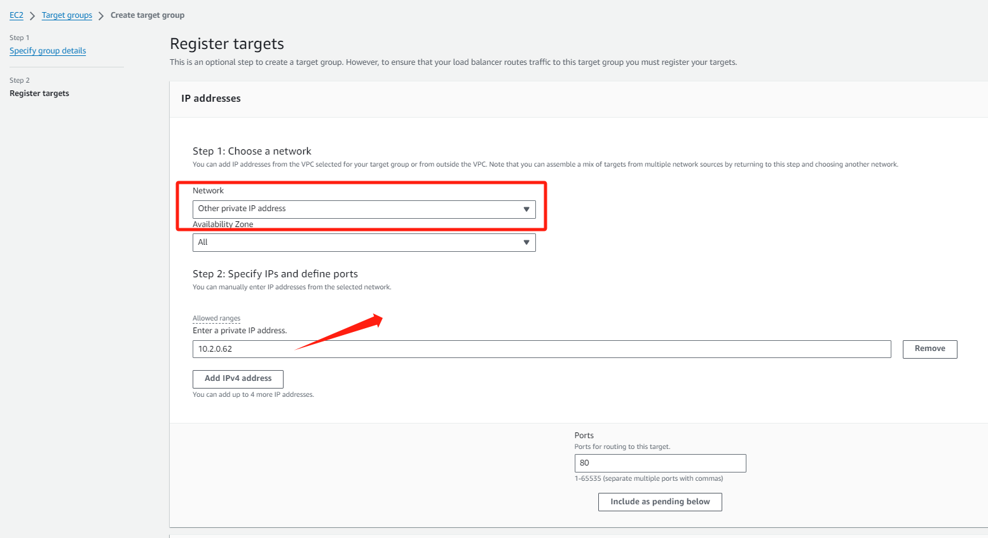
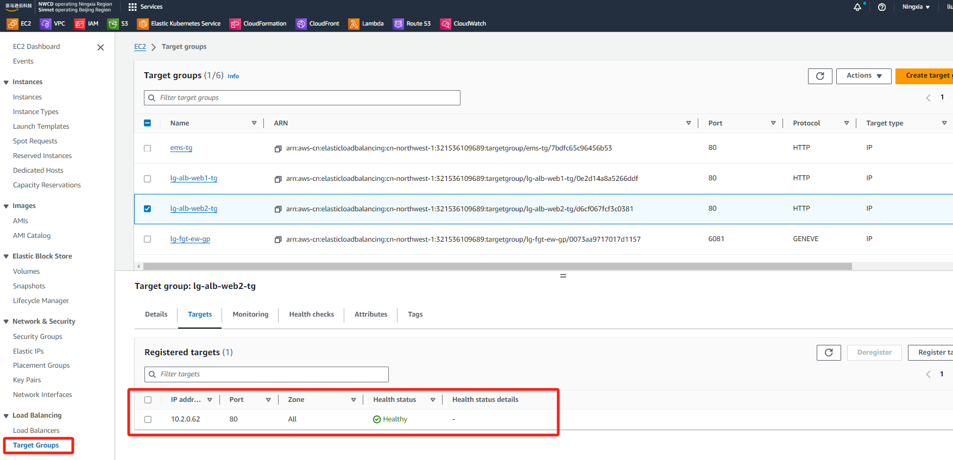
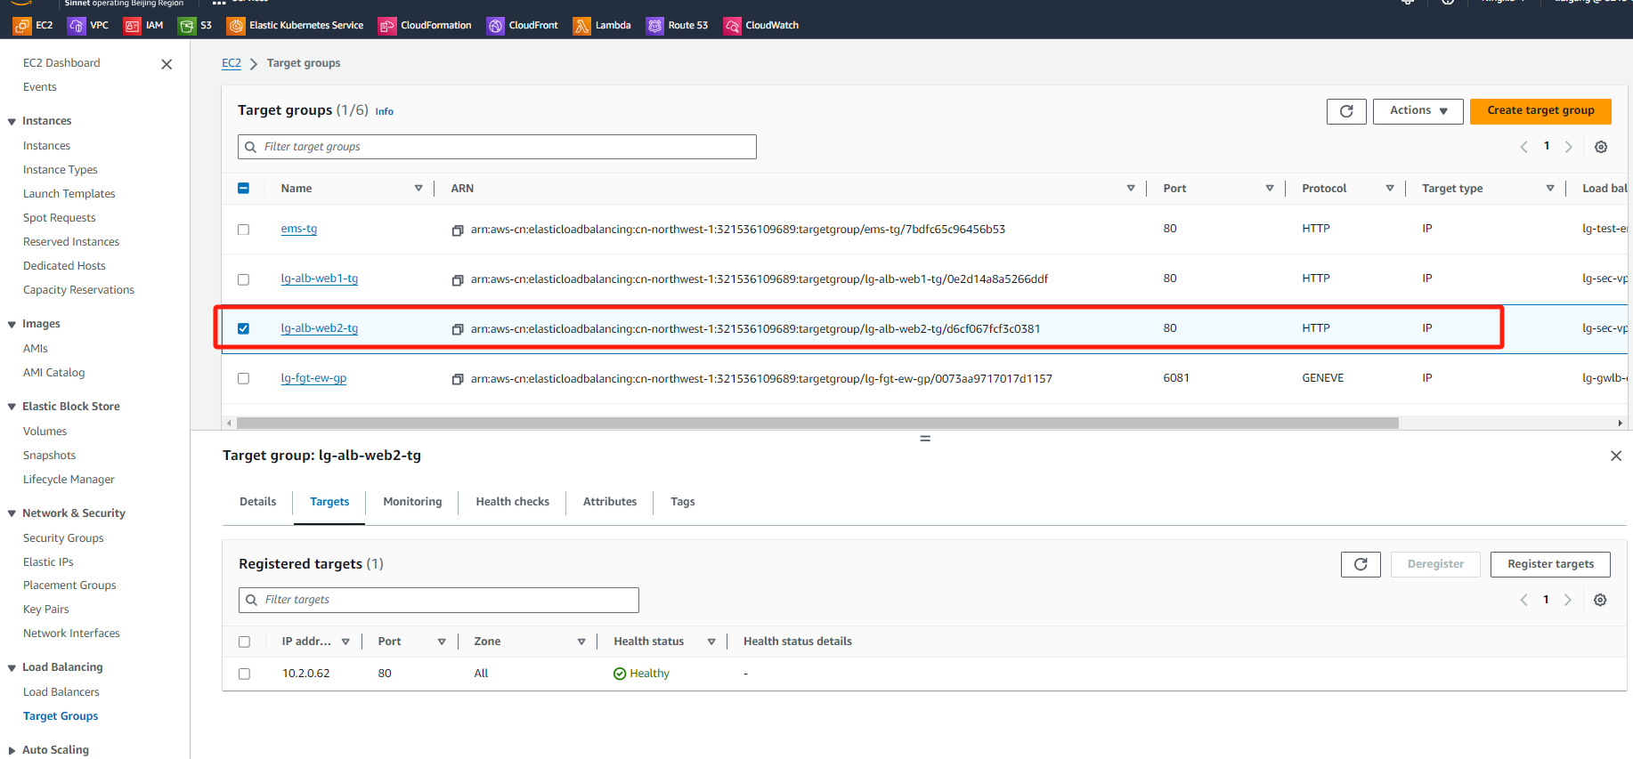
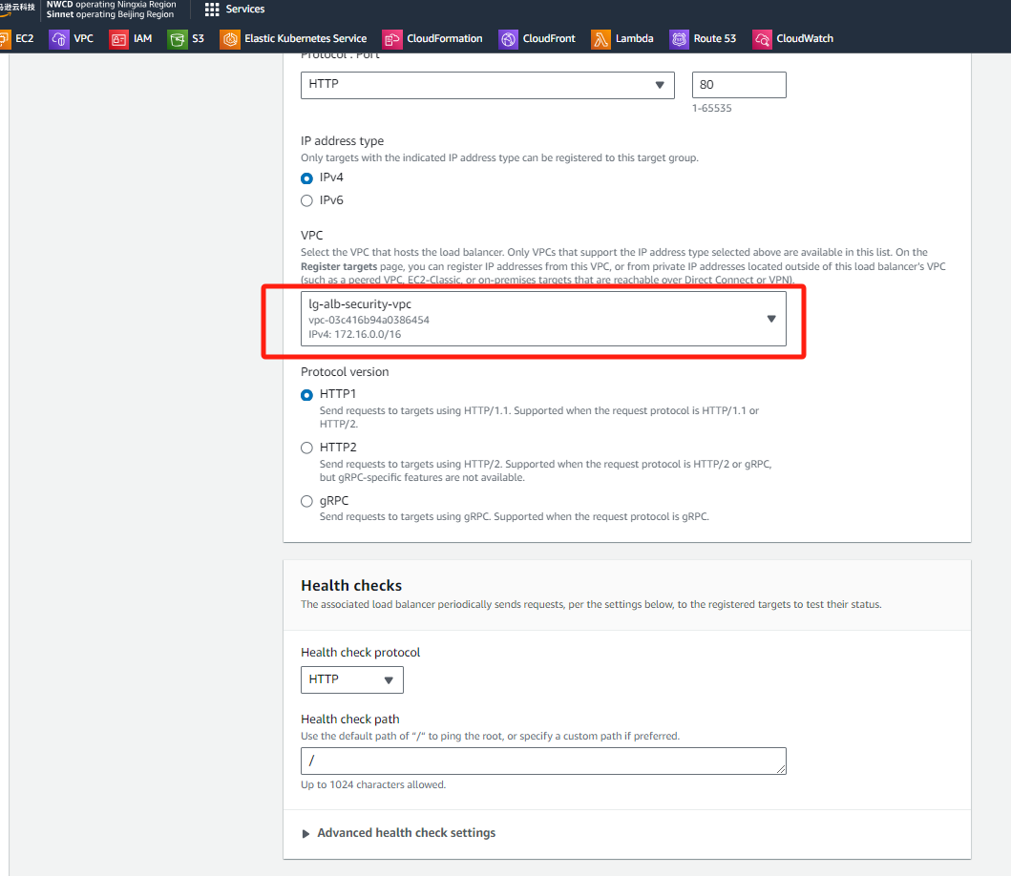





业务ALB-2

Slide 23


NAT规划

Slide 24



App-1 路由表-1

Slide 25


App-1 路由表-2

Slide 26



App-2 路由表-1

Slide 27


App-2 路由表-2

Slide 28


Sec vpc ingress路由表

Slide 29


GWLBe-NS-IN 路由表

Slide 30


GWLBe-NS-OUT 路由表

Slide 31

FGT管理路由表

Slide 32


GWLBe-EW 路由表

Slide 33


Sec VPC TGW Attachment路由表

Slide 34


Alb-1路由表

Slide 35


Alb-2路由表

Slide 36


NAT路由表

Slide 37

业务测试-南北互访-1
Notes:
访问ALB对外发布的两个业务分别对应不同VPC的Server

Slide 38


业务测试-南北互访-2
Notes:
两台防火墙分别记录2个不同请求的业务会话

Slide 39

业务测试-南北互访-3
Notes:
远程通过跳板机访问app-web-1 server 去访问公网和测试下载病毒文件

Slide 40


业务测试-南北互访-4
Notes:
防火墙阻断下载病毒请求和放通了PING流量

Slide 41

业务测试-东西互访-1
Notes:
远程通过跳板机访问app-web-1 server 去访问app-web-2 server 应用和ICMP

Slide 42

业务测试-东西互访-2
Notes:
防火墙放通流量日志

